Slide 1



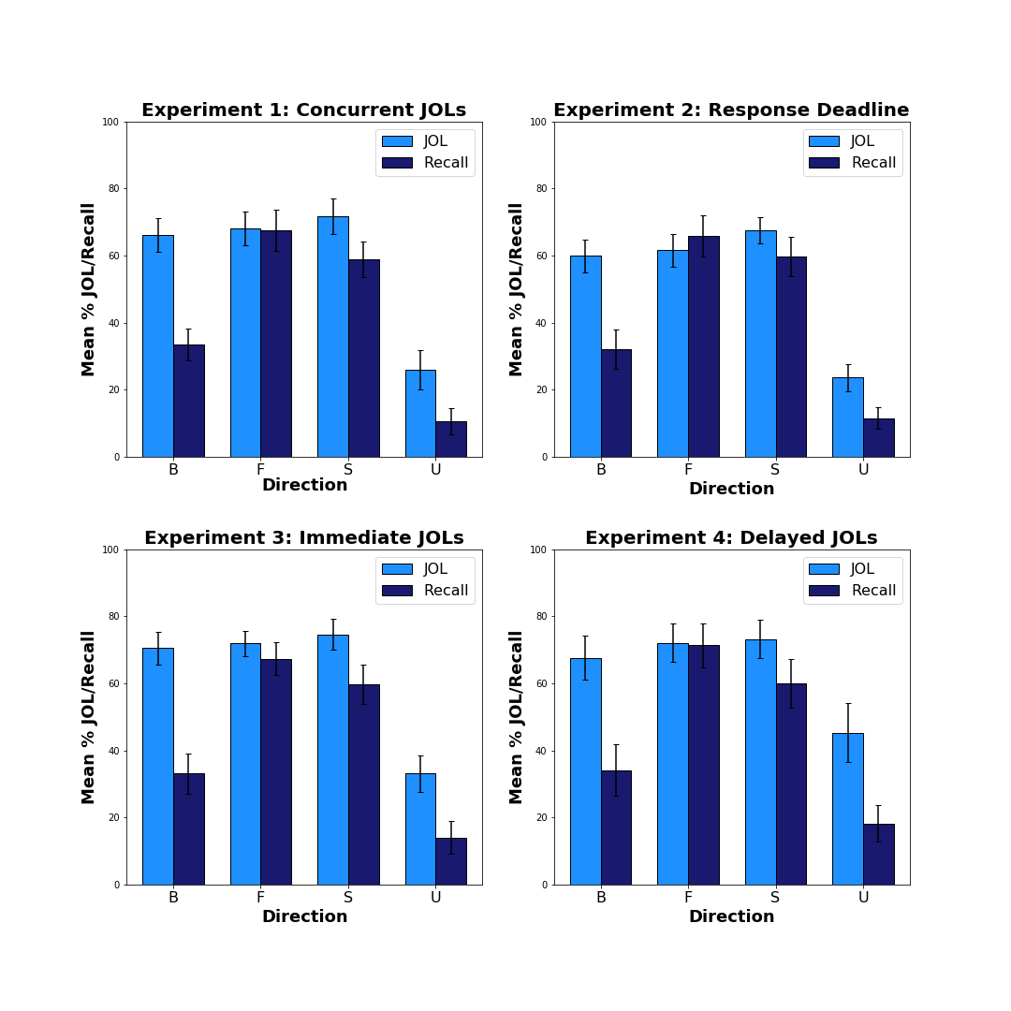
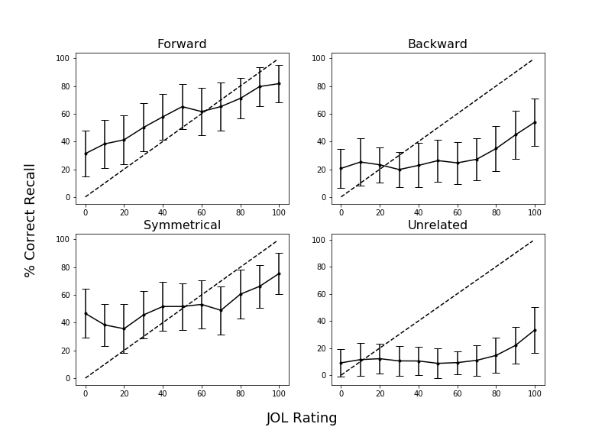
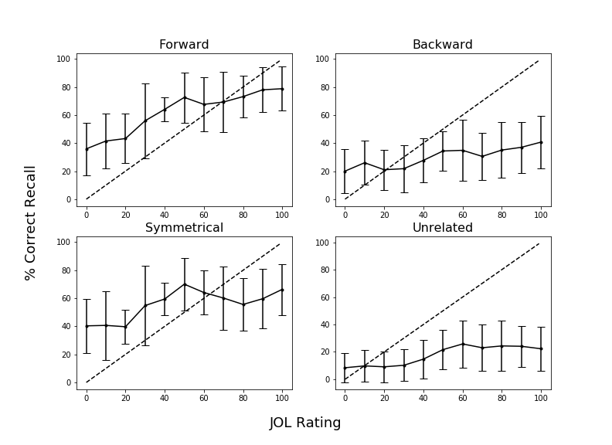
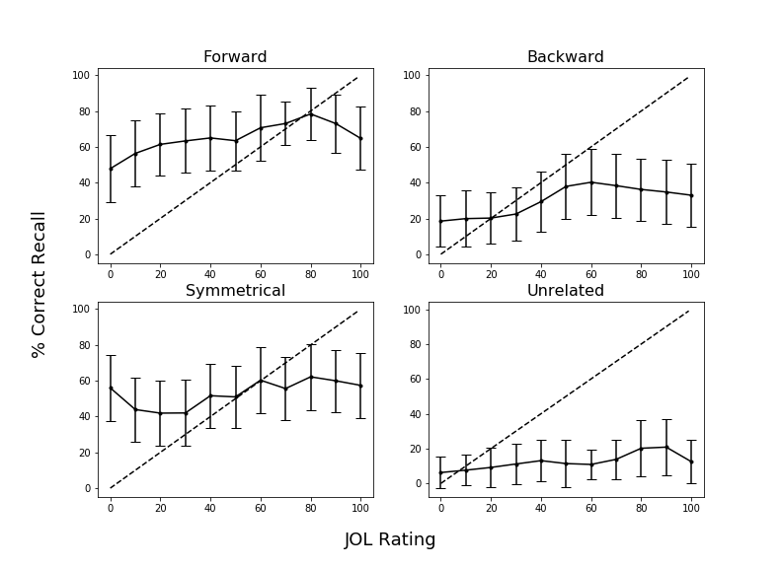
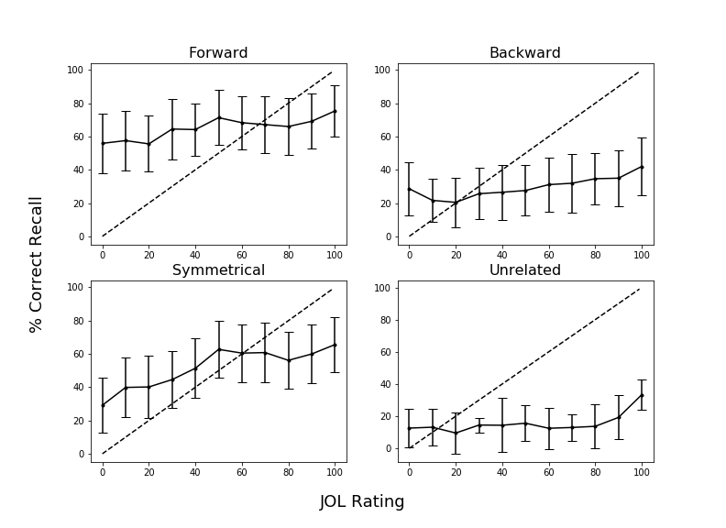
Relations are not Always Beneficial: The Effect of Associative Direction on Judgments of Learning
Nicholas P. Maxwell & Mark J. Huff
Introduction
Examining the relationship between one’s predicted and actual memory performance is a primary goal of metamemory researchers. A common method for examining this relationship is instructing participants to provide judgments of learning (JOLs) in which participants rate the probability that they will be able to later recall a target word from a studied cue-target pair (e.g., bank-interest).
JOL accuracy is sensitive to the strength and direction of association between the cue-target pairs. Koriat and Bjork (2005) showed that when forward associates are studied (e.g., red-hot), JOLs are calibrated to later recall accuracy. However, an illusion of competence was found for backward associates (e.g., hot-red) in which JOL estimates exceeded later cued recall—a pattern that extends to identical pairs (Castel, et al., 2007).
The present study builds upon previous findings by comparing asymmetric forward and backward associates to symmetrical associates (e.g., on-off) and unrelated pairs (e.g., cat-pencil) to more closely test the role of associative direction on JOLs and cued-recall accuracy. Additionally, we provide calibration plots, which plot JOL ratings as a function of recall accuracy to determine whether the calibration between JOLs and recall depends upon the relative JOL rating that is provided.
In Experiment 1, participants made concurrent JOLs at study. Experiment 2 used a 5s study/JOL deadline to limit encoding duration. Experiment 3 used a standard immediate JOL manipulation in which JOLs were elicited immediately following study. Finally, Experiment 4 employed a delayed JOL task in which participants solved arithmetic problems in between pair study and when judgments were elicited.
Results: Recall/JOLs
Calibration Cont.
Experiment 3: Immediate JOLs
Bars = 95% CIs
Experiment 4: Delayed JOLs
Bars = 95% CIs
Bars = 95% CI
Calibration Plots
Experiment 1: Concurrent JOLs
Bars = 95% CIs
Materials
Note: Overestimation indicated by points falling below the calibration line.
Forward Pairs
Wage – Money
Editor – News
Way – Out
Credit – Card
Backward Pairs
Money – Wage
News – Editor
Out – Way
Card – Credit
Symmetrical Pairs
Due – Assignment
Shoe – Foot
Honey – Bee
Circle – Round
Unrelated Pairs
Park – Hungry
Soon – Belt
Discover – Floor
Artery – Bronze
Conclusions
Consistent patterns emerged across the four experiments. For backwards pairs, JOLs ratings exceeded later recall rates—an illusion of competence. A similar illusion pattern was found for symmetrical and unrelated pairs, though at a reduced magnitude. Forward pairs, in contrast, were well calibrated, with JOLs closely estimating later recall rates. Calibration plots indicated that JOL overconfidence similarly differed across pair types. Symmetrical and forward overconfidence rates only occurred at relatively high JOL ratings (80% or greater), whereas backward and unrelated pairs showed recall overconfidence at much lower JOL ratings.
Experiment 2 examined whether including a deadline for study and JOL ratings would affect JOL/Recall calibration. It was expected that less time spent at encoding should result in fewer items correctly recalled (increasing the illusion of competence). This pattern was not in evidence. Thus, the effectiveness of forward cues in aiding target retrieval makes them resistant to illusions of competence, even with limited time to provide JOLs. Experiment 3 showed that pair effects on calibration extend to a standard immediate JOL task. Finally, Experiment 4 tested whether a delayed JOL manipulation would reduce the illusion of competence by resulting in greater calibration between JOL ratings and recall. It was expected that making JOLs after a delay involving a working memory taxing distractor would improve calibration (e.g., Dunlosky & Nelson, 1994). However, the illusion of competence persisted. Future work should evaluate other means to improve JOL/recall accuracy calibration by training participants about how backward associates can mislead memory estimates.
Our analyses improve upon existing work by assessing the relationship between JOLs and accuracy. Our experiments carefully controlled for potential item effects that may have contributed to memory/JOL effects in previous studies. Additionally, our study included symmetrical pairs, a novel comparison, that were equated to backward and forward pairs on lexical and semantic characteristics. Calibration for symmetrical pairs was in between calibration for forward and backward pairs. Thus, the effectiveness for the cue in eliciting the target in the forward direction is critical for high JOL/recall calibration.
40 pairs were created for each pair type and were matched on associative strength (Nelson et al., 2004), word length, concreteness and frequency (Balota et al., 2007)
General Method
Experiment 2: Response Deadline
Bars = 95% CIs
Study/JOL:
JOL Ratings
(0-100 Scale)
Forward, Backward, Unrelated, and Symmetrical Pairs
Test:
Cued-Recall
Filler Task
Experiment 1: Concurrent JOLs
Experiment 2: Concurrent JOLs w/ Response Deadline (5s)
Experiment 3: Immediate JOLs; pair unavailable during JOL rating
Experiment 4: JOLs delayed by OSPAN math problem
Note: Overestimation indicated by points falling below the calibration line.
Correspondence can be addressed to nicholas.maxwell@usm.edu. More info available at: https://osf.io/hvdma/|www.macapsych.com

